Slide 1

William Stallings Computer Organization and Architecture 9th Edition
Notes:
Lecture slides prepared for “Computer Organization and Architecture”, 9/e, by William Stallings, Chapter 6 “External Memory”.

Slide 2
Bölüm6
Harici Bellek
Notes:
This chapter examines a range of external memory devices and systems. We begin
with the most important device, the magnetic disk. Magnetic disks are the foundation
of external memory on virtually all computer systems. The next section examines
the use of disk arrays to achieve greater performance, looking specifically at
the family of systems known as RAID (Redundant Array of Independent Disks).
An increasingly important component of many computer systems is the solid state
disk, which is discussed next. Then, external optical memory is examined. Finally,
magnetic tape is described.

Slide 3

Manyetik Disk
Dairesel bir plaka olan manyetik disk, manyetik olmayan bir dairesel plakanın (substrate) manyetikleştirilebilir malzeme ile kaplanmasından oluşur.
Genellikle, manyetik olmayan alt plaka ya direk olarak alüminyumdur ya da alüminyum alaşımı bir maddeden yapılmıştır.
Son yıllarda cam malzemeden üretilen plakaların tanıtımı yapılmaya başlanmıştır
Cam malzemeden üretilen plakaların faydaları:
Disk güvenilirliğini artırmak için manyetik film yüzeyinin güvenilirliğinde iyileştirme
Okuma-yazma hatalarını azaltmaya yardımcı olmak için genel yüzey kusurlarında önemli bir azalma
Veriye ulaşmada kısa mesafeyi destekleme yeteneği
Disk titreşimlerini azaltmak için daha sağlam sertlik
Şoklara ve hasara karşı daha dayanıklılık
Notes:
A disk is a circular platter constructed of nonmagnetic material, called the substrate,
coated with a magnetizable material. Traditionally, the substrate has been an aluminum
or aluminum alloy material. More recently, glass substrates have been introduced.
The glass substrate has a number of benefits, including the following:
• Improvement in the uniformity of the magnetic film surface to increase disk
reliability
• A significant reduction in overall surface defects to help reduce read-write errors
• Ability to support lower fly heights (described subsequently)
• Better stiffness to reduce disk dynamics
• Greater ability to withstand shock and damage

Slide 4
Manyetik Okuma ve Yazma Mekanizmaları
Veriler disk üzerinde kaydedilir ve daha sonra kafa olarak adlandırılan bir iletken bobin üzerinden alınır
Pek çok sistemde okuma ve yazma kafası olmak üzere iki kafa bulunmaktadır.
Okuma veya yazma işlemi sırasında, plaka altta dönerken kafa sabittir.
Yazma mekanizması, bir bobin içinden akan elektriğin bir manyetik alan oluşturduğu gerçeğinden yararlanır
Farklı pozitif ve negatif akımlar şeklinde yollanan elektriksel darbeler yazma kafasına gönderilir ve ortaya çıkan manyetik desenler, aşağıdaki yüzeyde kaydedilir
Yazma kafası kolay manyetize edilebilen, bir tarafında iki ucu arasında boşluk bulunan, diğer tarafında ise birkaç sarımlık iletken tel olan dikdörtgensel bir yapıdır.
Telin içindeki bir elektrik akımı boşluk boyunca manyetik bir alanı indükler ve bu da kayıt aracının küçük bir alanını manyetize eder
Ters akım verildiğinde kayıt alanı üzerindeki manyetizasyon yönü de değişir
Notes:
Data are recorded on and later retrieved from the disk via a conducting coil named
the head; in many systems, there are two heads, a read head and a write head. During
a read or write operation, the head is stationary while the platter rotates beneath it.
The write mechanism exploits the fact that electricity flowing through a coil
produces a magnetic field. Electric pulses are sent to the write head, and the resulting
magnetic patterns are recorded on the surface below, with different patterns for
positive and negative currents. The write head itself is made of easily magnetizable
material and is in the shape of a rectangular doughnut with a gap along one side and
a few turns of conducting wire along the opposite side (Figure 6.1). An electric current
in the wire induces a magnetic field across the gap, which in turn magnetizes a
small area of the recording medium. Reversing the direction of the current reverses
the direction of the magnetization on the recording medium.
The traditional read mechanism exploits the fact that a magnetic field moving
relative to a coil produces an electrical current in the coil. When the surface of the
disk passes under the head, it generates a current of the same polarity as the one
already recorded. The structure of the head for reading is in this case essentially
the same as for writing and therefore the same head can be used for both. Such
single heads are used in floppy disk systems and in older rigid disk systems.
Contemporary rigid disk systems use a different read mechanism, requiring
a separate read head, positioned for convenience close to the write head. The read
head consists of a partially shielded magnetoresistive (MR) sensor. The MR material
has an electrical resistance that depends on the direction of the magnetization of
the medium moving under it. By passing a current through the MR sensor, resistance
changes are detected as voltage signals. The MR design allows higher-frequency
operation, which equates to greater storage densities and operating speeds.

Slide 5
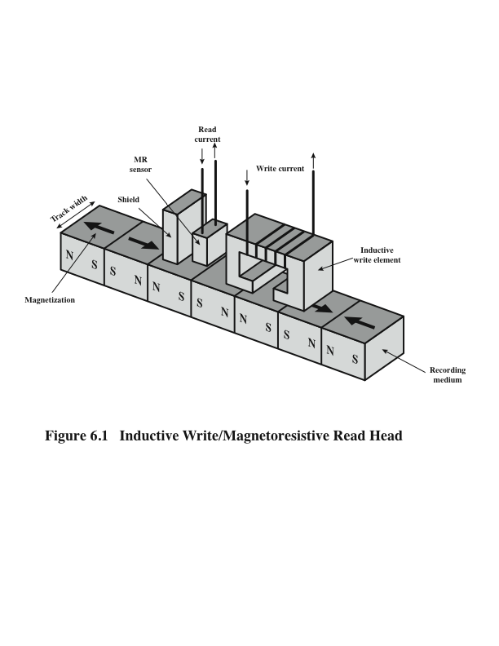
İndüktif Yazma / Manyetoresistif Okuma Kafası
Notes:
Figure 6.1. Inductive Write/Magnetoresistive Read Head

Slide 6
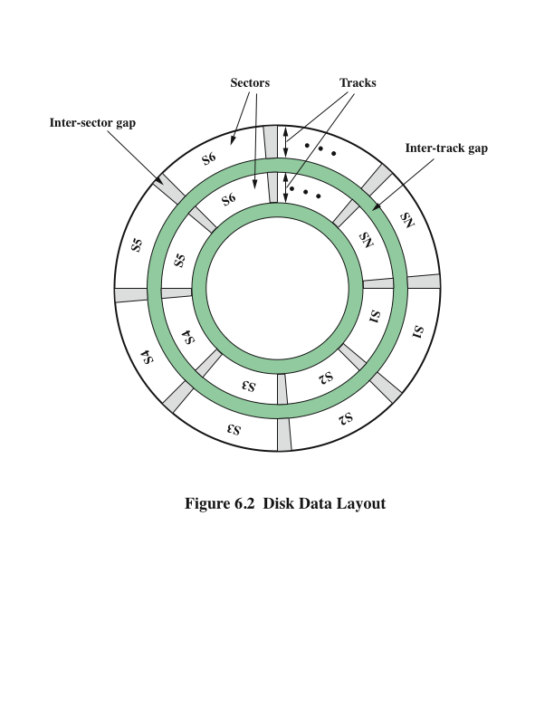
Disk Veri Yerleşimi
Notes:
The head is a relatively small device capable of reading from or writing to a portion
of the platter rotating beneath it. This gives rise to the organization of data on the
platter in a concentric set of rings, called tracks. Each track is the same width as the
head. There are thousands of tracks per surface.
Figure 6.2 depicts this data layout. Adjacent tracks are separated by gaps. This
prevents, or at least minimizes, errors due to misalignment of the head or simply
interference of magnetic fields.
Data are transferred to and from the disk in sectors (Figure 6.2). There are
typically hundreds of sectors per track, and these may be of either fixed or variable
length. In most contemporary systems, fixed-length sectors are used, with 512 bytes
being the nearly universal sector size. To avoid imposing unreasonable precision
requirements on the system, adjacent sectors are separated by intratrack (intersector)
gaps.

Slide 7
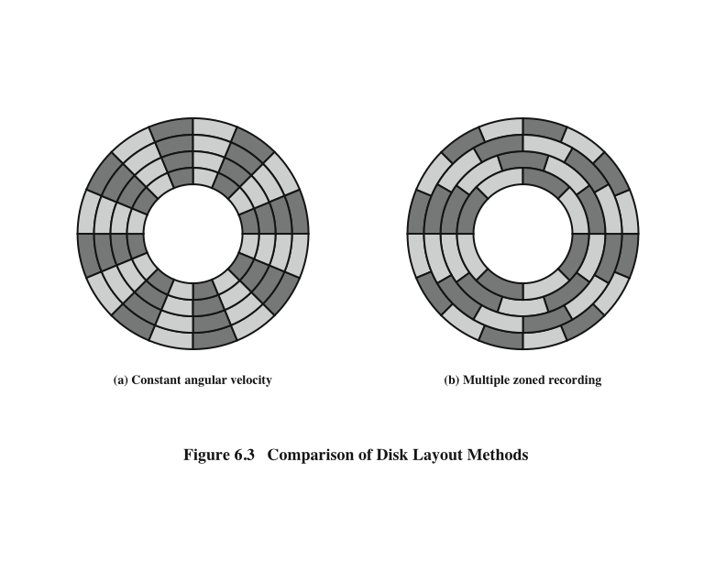
Disk Yerleşim Metotlarının Diyagramı
Notes:
A bit near the center of a rotating disk travels past a fixed point (such as a read–
write head) slower than a bit on the outside. Therefore, some way must be found
to compensate for the variation in speed so that the head can read all the bits at the
same rate. This can be done by increasing the spacing between bits of information
recorded in segments of the disk. The information can then be scanned at the same
rate by rotating the disk at a fixed speed, known as the constant angular velocity
(CAV). Figure 6.3a shows the layout of a disk using CAV. The disk is divided into
a number of pie-shaped sectors and into a series of concentric tracks. The advantage
of using CAV is that individual blocks of data can be directly addressed by
track and sector. To move the head from its current location to a specific address, it
only takes a short movement of the head to a specific track and a short wait for the
proper sector to spin under the head. The disadvantage of CAV is that the amount
of data that can be stored on the long outer tracks is the only same as what can be
stored on the short inner tracks.
Because the density, in bits per linear inch, increases in moving from the outermost
track to the innermost track, disk storage capacity in a straightforward CAV
system is limited by the maximum recording density that can be achieved on the
innermost track. To increase density, modern hard disk systems use a technique
known as multiple zone recording, in which the surface is divided into a number
of concentric zones (16 is typical). Within a zone, the number of bits per track is
constant. Zones farther from the center contain more bits (more sectors) than zones
closer to the center. This allows for greater overall storage capacity at the expense
of somewhat more complex circuitry. As the disk head moves from one zone to
another, the length (along the track) of individual bits changes, causing a change
in the timing for reads and writes. Figure 6.3b suggests the nature of multiple zone
recording; in this illustration, each zone is only a single track wide.

Slide 8
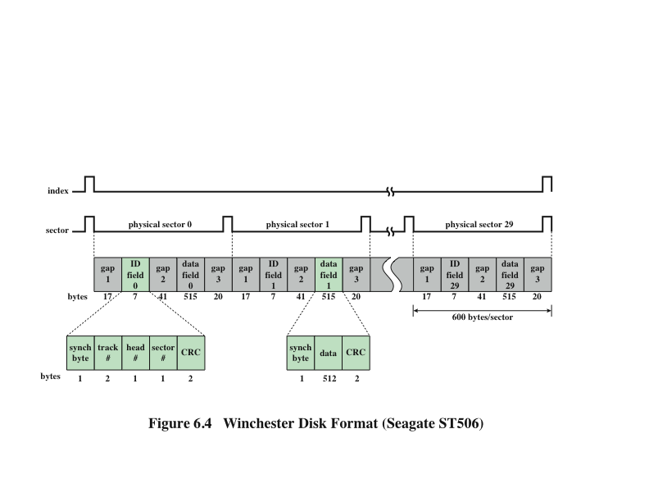
Winchester Disk Formatı Seagate ST506
Notes:
Some means is needed to locate sector positions within a track. Clearly, there
must be some starting point on the track and a way of identifying the start and end
of each sector. These requirements are handled by means of control data recorded
on the disk. Thus, the disk is formatted with some extra data used only by the disk
drive and not accessible to the user.
An example of disk formatting is shown in Figure 6.4. In this case, each track
contains 30 fixed-length sectors of 600 bytes each. Each sector holds 512 bytes of
data plus control information useful to the disk controller. The ID field is a unique
identifier or address used to locate a particular sector. The SYNCH byte is a special
bit pattern that delimits the beginning of the field. The track number identifies a
track on a surface. The head number identifies a head, because this disk has multiple
surfaces (explained presently). The ID and data fields each contain an error detecting
code.

Slide 9
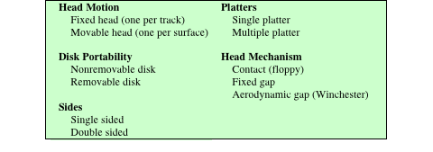
Tablo 6.1 Disk Sistemlerinin Fiziksel Karakteristikleri
Tablo 6.1 Disk Sistemlerinin Fiziksel Karakteristikleri
Notes:
Table 6.1 lists the major characteristics that differentiate among the various types
of magnetic disks.

Slide 10
Karakteristikler
Sabit kafalı disk
Her iz (track) başına bir okuma-yazma kafası
Kafalar, tüm izlerin üzerinde uzanan sabit bir dirsekli kol üzerine monte edilmiştir
Hareketli kafalı disk
Bir okuma-yazma kafası
Kafa kol üzerine monte edilmiştir
Kol uzatılabilir ya da kısaltılabilir
Çıkarılabilir disk
Çıkarılabilir ve başka bir diskle yer değiştirilebilir
Avantajları:
Sınırlı sayıda disk sistemi ile sınırsız miktarda veri mevcuttur
Disk bir bilgisayar sisteminden diğerine taşınabilir
Floppy diskler and ZIP kartuş diskleri çıkarılabilir disklere örnek olarak verilebilir
Çıkarılabilir olmayan disk
Disk sürücüsüne kalıcı olarak monte edilmiştir
Kişisel bilgisayardaki sabit disk çıkarılabilir olmayan bir disktir
Çift Taraflı Disk
Mıknatıslanabilir kaplama plakanın her iki tarafına uygulanır
Notes:
First, the head may either be fixed or movable with respect to
the radial direction of the platter. In a fixed-head disk, there is one read-write
head per track. All of the heads are mounted on a rigid arm that extends across
all tracks; such systems are rare today. In a movable-head disk, there is only one
read-write head. Again, the head is mounted on an arm. Because the head must
be able to be positioned above any track, the arm can be extended or retracted for
this purpose.
The disk itself is mounted in a disk drive, which consists of the arm, a spindle
that rotates the disk, and the electronics needed for input and output of binary data.
A non-removable disk is permanently mounted in the disk drive; the hard disk in
a personal computer is a non-removable disk. A removable disk can be removed
and replaced with another disk. The advantage of the latter type is that unlimited
amounts of data are available with a limited number of disk systems. Furthermore,
such a disk may be moved from one computer system to another. Floppy disks and
ZIP cartridge disks are examples of removable disks.
For most disks, the magnetizable coating is applied to both sides of the platter,
which is then referred to as double sided. Some less expensive disk systems use
single-sided disks.

Slide 11
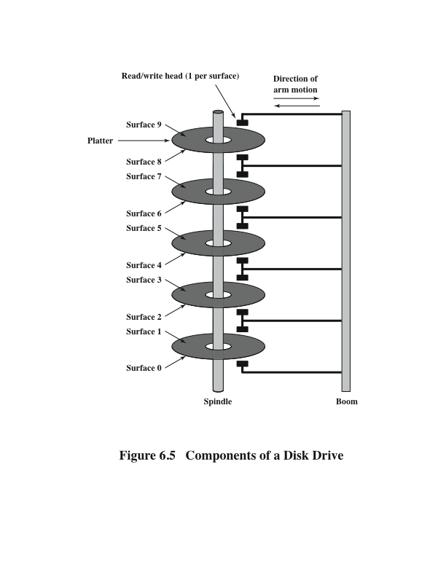
Çoklu Plakalar
Notes:
Some disk drives accommodate multiple platters stacked vertically a fraction
of an inch apart. Multiple arms are provided (Figure 6.5). Multiple–platter disks
employ a movable head, with one read-write head per platter surface. All of the
heads are mechanically fixed so that all are at the same distance from the center of
the disk and move together. Thus, at any time, all of the heads are positioned over
tracks that are of equal distance from the center of the disk.

Slide 12
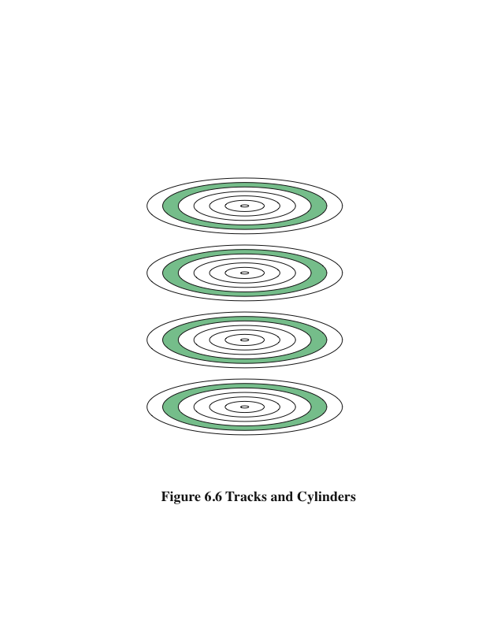
İzler
Silindirler
Notes:
The set of all the tracks
in the same relative position on the platter is referred to as a cylinder.
For example, all of the shaded tracks in Figure 6.6 are part of one cylinder.

Slide 13
Disk Sınıflandırması
Kafa mekanizması, disklerin üç tip halinde sınıflandırılmasını sağlar
Winchester Kafaları
Kafa, düzgün bir şekilde yazmak ve okumak için yeterli büyüklüğe sahip bir elektromanyetik alan üretmeli veya algılamalıdır.
Kafası ne kadar dar olursa, işlevini yerine getirebilmesi için plaka yüzeyine o kadar yakın olmalıdır
Daha dar bir kafa, dar izler anlamına gelir ve bu nedenle daha büyük veri yoğunluğu
Kafa diske ne kadar yakın olursa, kirlilik veya kusurlardan kaynaklanan hata riski o kadar yüksek olur
Kirlenmeye maruz kalamayacak kapalı sürücü tertibatlarında kullanılır
Geleneksel disk kafalarına göre disk yüzeyine daha yakın çalışacak şekilde tasarlandığından daha fazla veri yoğunluğu sağlanır
Aslında disk hareketsiz olduğunda plakanın yüzeyine hafifçe dayanan aerodinamik bir folyodur
Bir dönen disk tarafından üretilen hava basıncı, folyonun yüzeyin üzerinde yükselmesini sağlamak için yeterlidir
Notes:
Finally, the head mechanism provides a classification of disks into three types.
Traditionally, the read-write head has been positioned a fixed distance above the
platter, allowing an air gap. At the other extreme is a head mechanism that actually
comes into physical contact with the medium during a read or write operation. This
mechanism is used with the floppy disk, which is a small, flexible platter and the
least expensive type of disk.
To understand the third type of disk, we need to comment on the relationship
between data density and the size of the air gap. The head must generate or sense an
electromagnetic field of sufficient magnitude to write and read properly. The narrower
the head is, the closer it must be to the platter surface to function. A narrower
head means narrower tracks and therefore greater data density, which is desirable.
However, the closer the head is to the disk, the greater the risk of error from impurities
or imperfections. To push the technology further, the Winchester disk was
developed. Winchester heads are used in sealed drive assemblies that are almost
free of contaminants. They are designed to operate closer to the disk’s surface than
conventional rigid disk heads, thus allowing greater data density. The head is actually
an aerodynamic foil that rests lightly on the platter’s surface when the disk is
motionless. The air pressure generated by a spinning disk is enough to make the foil
rise above the surface. The resulting noncontact system can be engineered to use
narrower heads that operate closer to the platter’s surface than conventional rigid
disk heads.

Slide 14
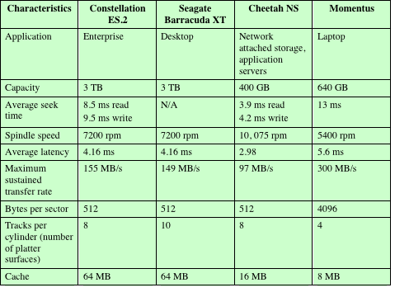
Tipik Hard Disk Parametreleri
Tablo 6.2 Tipik Hard Disk Sürücüsü Parametreleri
Notes:
Table 6.2 gives disk parameters for typical contemporary high-performance
disks.

Slide 15
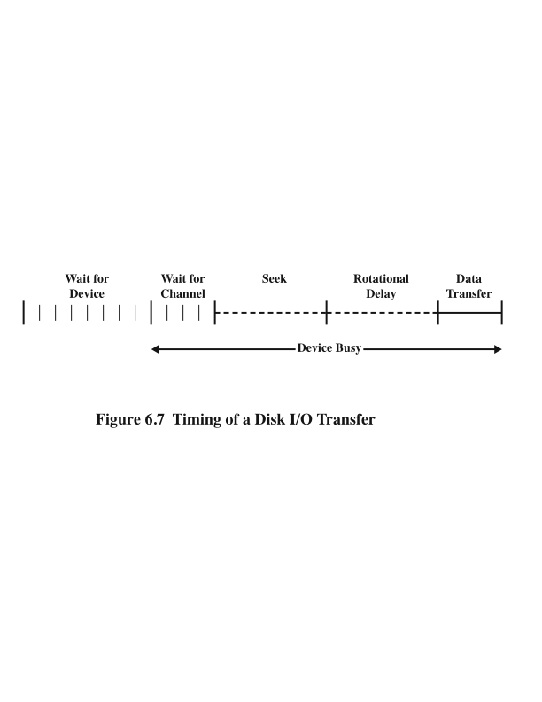
Diskten I/O’ya Transferin Zamanlanması
Notes:
The actual details of disk I/O operation depend on the computer system, the operating
system, and the nature of the I/O channel and disk controller hardware. A
general timing diagram of disk I/O transfer is shown in Figure 6.7.

Slide 16
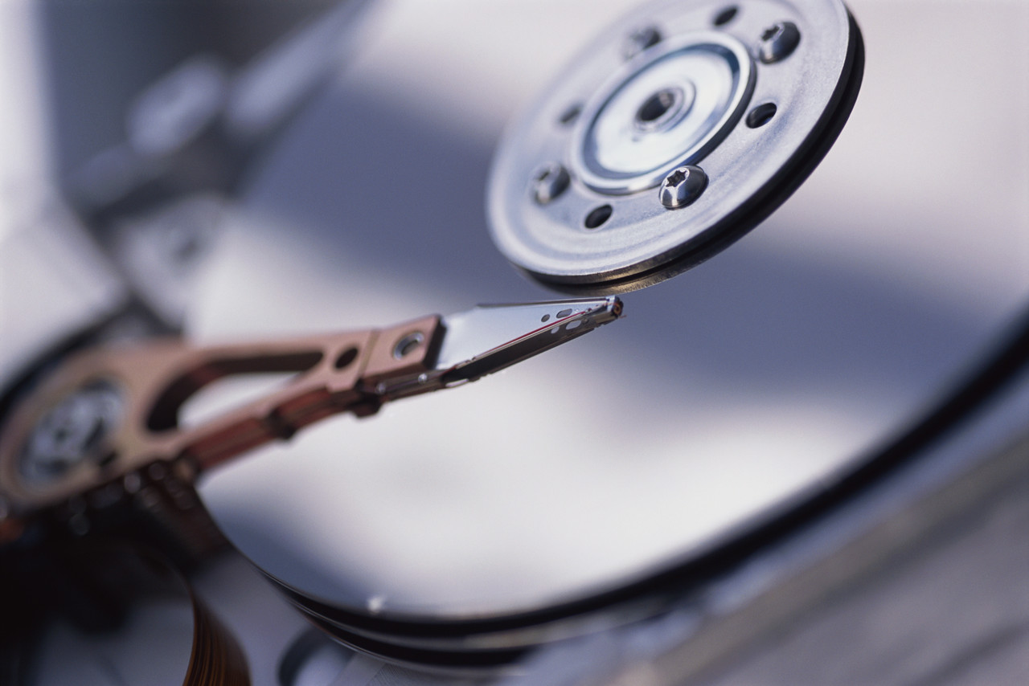
Disk Performans Parametreleri
Disk sürücüsü çalışıyorken disk sabit hızda döner
Kafa okuma veya yazma için, istenen sektörde ve istenilen izin başında olacak şekilde konumlandırılmalıdır
İz seçimi, kafanın hareketli kafalı bir sistemde hareket ettirilmesini veya sabit kafalı bir sistem üzerinde bir kafanın elektronik olarak seçilmesini içerir
İz seçildikten sonra, disk kontrolcüsü uygun sektörün kafa ile aynı hizaya gelmesini bekler
Arama süresi
Hareketli kafalı bir sistemde kafanın iz üzerinde konumlandırılması için geçen süre
Dönme gecikmesi (rotational delay/latency)
Sektörün başından kafaya ulaşmak için gereken süre
Erişim zamanı
Arama süresi+Dönme gecikmesi
Okuma ya da yazma pozisyonu almak için gereken süre
Transfer zamanı
Kafa pozisyonuna girdikten sonra, okuma veya yazma işlemi, sektör başın altında hareket ederken gerçekleştirilir
İşlemin veri aktarım kısmı budur
Notes:
When the disk drive is operating, the disk is rotating at constant speed. To
read or write, the head must be positioned at the desired track and at the beginning
of the desired sector on that track. Track selection involves moving the head in a
movable-head system or electronically selecting one head on a fixed-head system.
On a movable-head system, the time it takes to position the head at the track is
known as seek time. In either case, once the track is selected, the disk controller
waits until the appropriate sector rotates to line up with the head. The time it takes
for the beginning of the sector to reach the head is known as rotational delay, or
rotational latency. The sum of the seek time, if any, and the rotational delay equals
the access time, which is the time it takes to get into position to read or write. Once
the head is in position, the read or write operation is then performed as the sector
moves under the head; this is the data transfer portion of the operation; the time
required for the transfer is the transfer time.
It is clear that the order in which sectors are read from the disk has a tremendous
effect on I/O performance. In the case of file access in which multiple
sectors are read or written, we have some control over the way in which sectors
of data are deployed. However, even in the case of a file access, in a multiprogramming
environment, there will be I/O requests competing for the same disk.
Thus, it is worthwhile to examine ways in which the performance of disk I/O
can be improved over that achieved with purely random access to the disk. This
leads to a consideration of disk scheduling algorithms, which is the province of
the operating system and beyond the scope of this book (see [STAL12] for a
discussion).

Slide 17
RAID
7 seviyeden oluşur
Burada, seviye ile hiyerarşik bir ilişki kastedilmemektedir, üç ortak özelliği paylaşan farklı tasarım mimarileri kastedilmektedir:
İşletim sistemi tarafından tek bir mantıksal sürücü olarak görüntülenen fiziksel disk sürücüleri seti
Veri, bir dizinin fiziksel sürücülerinde şeritleme olarak bilinen bir düzende dağıtılır
Yedek disk kapasitesi, bir disk arızasında veri kurtarılabilirliğini garanti eden eşlik bilgilerini depolamak için kullanılır
Redundant Array of Independent Disks
Notes:
With the use of multiple disks, there is a wide variety of ways in which the
data can be organized and in which redundancy can be added to improve reliability.
This could make it difficult to develop database schemes that are usable
on a number of platforms and operating systems. Fortunately, industry has
agreed on a standardized scheme for multiple-disk database design, known as
RAID (Redundant Array of Independent Disks). The RAID scheme consists
of seven levels, zero through six. These levels do not imply a hierarchical relationship
but designate different design architectures that share three common
characteristics:
1. RAID is a set of physical disk drives viewed by the operating system as a single
logical drive.
2. Data are distributed across the physical drives of an array in a scheme known
as striping, described subsequently.
3. Redundant disk capacity is used to store parity information, which guarantees
data recoverability in case of a disk failure.
The details of the second and third characteristics differ for the different RAID
levels. RAID 0 and RAID 1 do not support the third characteristic.

Slide 18
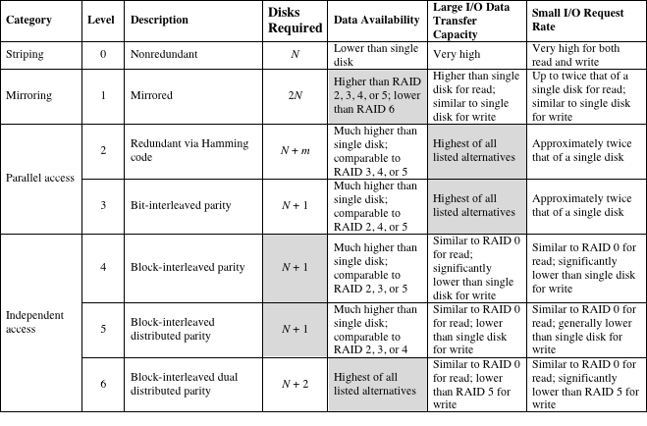
Tablo 6.3 RAID Seviyeleri
N = veri disklerinin sayısı; m log N ile orantılıdır
Notes:
We now examine each of the RAID levels. Table 6.3 provides a rough guide
to the seven levels. In the table, I/O performance is shown both in terms of data
transfer capacity, or ability to move data, and I/O request rate, or ability to satisfy
I/O requests, since these RAID levels inherently perform differently relative
to these two metrics. Each RAID level’s strong point is highlighted by darker
shading.

Slide 19
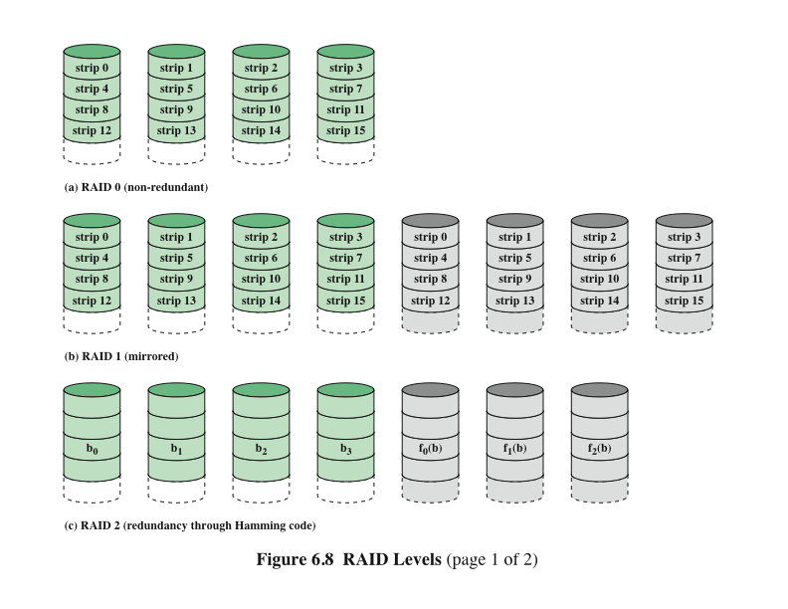
RAID Seviyeleri 0, 1, 2
Notes:
Figure 6.8 illustrates the use of the seven RAID schemes to support a
data capacity requiring four disks with no redundancy. The figures highlight the
layout of user data and redundant data and indicates the relative storage requirements
of the various levels. We refer to these figures throughout the following
discussion.

Slide 20
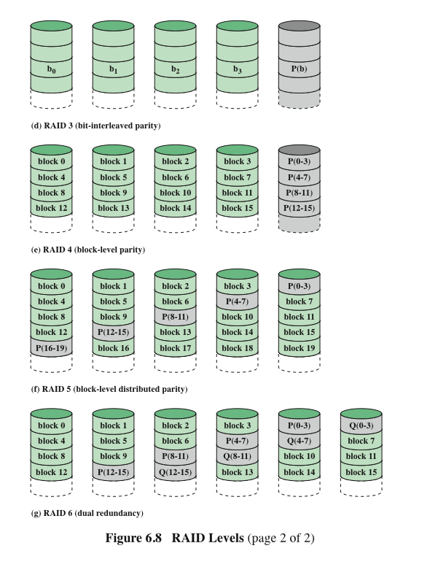
RAID Seviyeleri 3, 4, 5, 6
Notes:
Figure 6.8 continued.

Slide 21
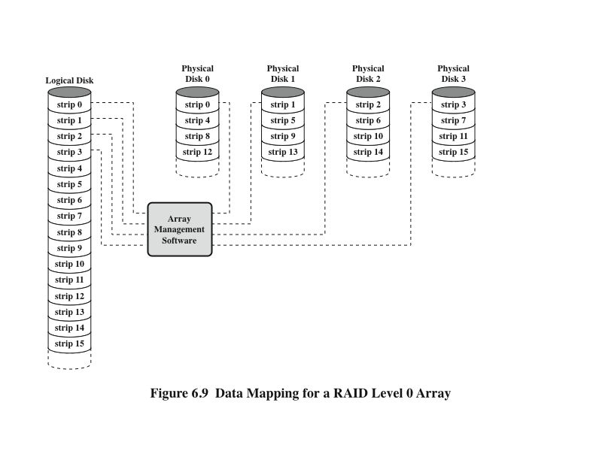
RAID Seviye 0 Dizisi için Veri Haritalama
Notes:
But RAID 0, as with all of the RAID levels, goes further than simply distributing
the data across a disk array: The data are striped across the available disks. This is
best understood by considering Figure 6.9. All of the user and system data are viewed
as being stored on a logical disk. The logical disk is divided into strips; these strips
may be physical blocks, sectors, or some other unit. The strips are mapped round
robin to consecutive physical disks in the RAID array. A set of logically consecutive
strips that maps exactly one strip to each array member is referred to as a stripe.
In an n-disk array, the first n logical strips are physically stored as the first strip on
each of the n disks, forming the first stripe; the second n strips are distributed as the
second strips on each disk; and so on. The advantage of this layout is that if a single
I/O request consists of multiple logically contiguous strips, then up to n strips for
that request can be handled in parallel, greatly reducing the I/O transfer time.
Figure 6.9 indicates the use of array management software to map between
logical and physical disk space. This software may execute either in the disk subsystem
or in a host computer.

Slide 22
RAID Seviye 0
Veri düzeninin ve sunucu sistemin isteklerinin sorunlarını giderir
Fazlalıktan etkilenme, analizle etkileşime girmez
Yüksek Veri Transfer Kapasitesi için RAID 0
RAID 0 için Yüksek I/O İstek Oranı
Uygulamalar için yüksek aktarım hızı elde etmek için iki gereklilik yerine getirilmelidir:
Sunucu bellek ile bağımsız disk sürücüleri arasındaki tüm yol boyunca yüksek bir aktarım kapasitesi olmalıdır
Uygulama, disk dizisini verimli bir şekilde yönlendiren I/O istekleri yapmalıdır
Küçük bir veri miktarının ayrı bir I/O isteği için I/O zamanına, arama süresi ve dönme gecikmesi hakimdir
Bir disk dizisi, I/O yükünü birden çok disk arasında dengeleyerek yüksek I/O çalıştırma oranları sağlayabilir
Şerit boyutu nispeten genişse, birden fazla bekleyen I/O isteği paralel olarak işlenebilir, böylece her istek için kuyruklama zamanı azaltılır
Notes:
The performance of any of the
RAID levels depends critically on the request patterns of the host system and on
the layout of the data. These issues can be most clearly addressed in RAID 0, where
the impact of redundancy does not interfere with the analysis. First, let us consider
the use of RAID 0 to achieve a high data transfer rate. For applications to experience
a high transfer rate, two requirements must be met. First, a high transfer capacity
must exist along the entire path between host memory and the individual disk drives.
This includes internal controller buses, host system I/O buses, I/O adapters, and host
memory buses.
The second requirement is that the application must make I/O requests that
drive the disk array efficiently. This requirement is met if the typical request is for
large amounts of logically contiguous data, compared to the size of a strip. In this
case, a single I/O request involves the parallel transfer of data from multiple disks,
increasing the effective transfer rate compared to a single-disk transfer.
In a transaction-oriented environment, the user is typically more concerned with
response time than with transfer rate. For
an individual I/O request for a small amount of data, the I/O time is dominated by the
motion of the disk heads (seek time) and the movement of the disk (rotational latency).
In a transaction environment, there may be hundreds of I/O requests per second.
A disk array can provide high I/O execution rates by balancing the I/O load
across multiple disks. Effective load balancing is achieved only if there are typically
multiple I/O requests outstanding. This, in turn, implies that there are multiple independent
applications or a single transaction-oriented application that is capable of
multiple asynchronous I/O requests. The performance will also be influenced by the
strip size. If the strip size is relatively large, so that a single I/O request only involves
a single disk access, then multiple waiting I/O requests can be handled in parallel,
reducing the queuing time for each request.

Slide 23
RAID Seviye1
Karakteristikler
Pozitif Yönleri
Artıklık elde edilme biçiminde RAID seviyelerinden (2'den 6'ya kadar) farklılık gösterir
Artıklık tüm verilerin çoğaltılmasının basit yolu ile sağlanır
Veri şeritleme kullanılır, ancak her mantıksal şerit iki ayrı fiziksel diske eşlenir; böylece dizideki her diskin aynı verileri içeren bir yansıtma diski bulunur
RAID 1, veri şeritleri olmadan da uygulanabilir, ancak yaygın değildir
Bir okuma isteği, istenen verileri içeren iki diskten biri tarafından sağlanabilir
"Yazma cezası" yoktur
Bir arızadan kurtarma işlemi basittir, bir sürücü başarısız olduğunda verilere ikinci sürücüden erişilebilir
Tüm verilerin gerçek zamanlı kopyasını sağlar
Taleplerin büyük kısmı okunursa, yüksek I/O istek oranları elde edebilirler
Başlıca dezavantajı maliyettir
Notes:
RAID 1 differs from RAID levels 2 through 6 in the way in which redundancy is
achieved. In these other RAID schemes, some form of parity calculation is used to
introduce redundancy, whereas in RAID 1, redundancy is achieved by the simple
expedient of duplicating all the data. As Figure 6.8b shows, data striping is used, as
in RAID 0. But in this case, each logical strip is mapped to two separate physical
disks so that every disk in the array has a mirror disk that contains the same data.
RAID 1 can also be implemented without data striping, though this is less common.
There are a number of positive aspects to the RAID 1 organization:
1. A read request can be serviced by either of the two disks that contains the requested
data, whichever one involves the minimum seek time plus rotational
latency.
2. A write request requires that both corresponding strips be updated, but this
can be done in parallel. Thus, the write performance is dictated by the slower
of the two writes (i.e., the one that involves the larger seek time plus rotational
latency). However, there is no “write penalty” with RAID 1. RAID levels
2 through 6 involve the use of parity bits. Therefore, when a single strip is
updated, the array management software must first compute and update the
parity bits as well as updating the actual strip in question.
3. Recovery from a failure is simple. When a drive fails, the data may still be
accessed from the second drive.
The principal disadvantage of RAID 1 is the cost; it requires twice the disk
space of the logical disk that it supports. Because of that, a RAID 1 configuration
is likely to be limited to drives that store system software and data and other highly
critical files. In these cases, RAID 1 provides real-time copy of all data so that in the
event of a disk failure, all of the critical data are still immediately available.
In a transaction-oriented environment, RAID 1 can achieve high I/O request
rates if the bulk of the requests are reads. In this situation, the performance of RAID 1
can approach double of that of RAID 0. However, if a substantial fraction of the I/O
requests are write requests, then there may be no significant performance gain over
RAID 0. RAID 1 may also provide improved performance over RAID 0 for data
transfer intensive applications with a high percentage of reads. Improvement occurs
if the application can split each read request so that both disk members participate.

Slide 24
RAID Seviye 2
Karakteristikleri
Performansı
Hata giderme kodu, her veri diskinde ilgili bitler boyunca hesaplanır ve kodun bitleri, çoklu eşlik diskleri üzerindeki karşılık gelen bit pozisyonlarında depolanır
Tipik olarak, tekli bit hatalarını düzeltebilen ve çift bit hatalarını tespit edebilen bir Hamming kodu kullanılır
Yedek disk sayısı, veri disklerinin sayısının logaritması ile orantılıdır
Yalnızca birçok disk hatasının oluştuğu bir ortamda etkili bir seçim olurdu
Paralel erişim tekniğini kullanır
Paralel erişim dizisinde tüm üye diskler her I/O isteğinin yürütülmesine katılırlar
Disklerin milleri, her bir disk kafasının herhangi bir zamanda her bir diskte aynı konumda olmasını sağlamak için senkronize edilir
Veri şeritleri kullanılır
Şeritler genellikle tek bir bayt veya kelime kadar küçük
Notes:
RAID levels 2 and 3 make use of a parallel access technique. In a parallel access
array, all member disks participate in the execution of every I/O request. Typically,
the spindles of the individual drives are synchronized so that each disk head is in the
same position on each disk at any given time.
As in the other RAID schemes, data striping is used. In the case of RAID 2
and 3, the strips are very small, often as small as a single byte or word. With RAID 2,
an error-correcting code is calculated across corresponding bits on each data disk,
and the bits of the code are stored in the corresponding bit positions on multiple
parity disks. Typically, a Hamming code is used, which is able to correct single-bit
errors and detect double-bit errors.
Although RAID 2 requires fewer disks than RAID 1, it is still rather costly.
The number of redundant disks is proportional to the log of the number of data
disks. On a single read, all disks are simultaneously accessed. The requested data
and the associated error-correcting code are delivered to the array controller. If
there is a single-bit error, the controller can recognize and correct the error instantly,
so that the read access time is not slowed. On a single write, all data disks and parity
disks must be accessed for the write operation.
RAID 2 would only be an effective choice in an environment in which many
disk errors occur. Given the high reliability of individual disks and disk drives,
RAID 2 is overkill and is not implemented.

Slide 25
RAID Seviye 3
Artıklık
Performansı
Disk dizisi ne kadar büyük olursa olsun, yalnızca bir yedek disk gerektirir
Küçük şeritlere dağıtılan verilere paralel erişim için kullanır
Hata düzeltme kodu yerine, tüm veri disklerinde aynı konumdaki bitler kümesi için basit bir eşlik biti hesaplanır
Çok yüksek veri aktarım hızlarına ulaşabilir
Sürücü arızasında, eşlik sürücüsüne erişilir ve veriler geri kalan cihazlardan yeniden oluşturulur
Arızalı sürücü değiştirildikten sonra eksik veriler yeni sürücüye geri yüklenebilir ve işlem devam ettirilebilir
Bir disk arızası olması durumunda, tüm veriler hala azaltılmış mod (reduced mode) olarak adlandırılan alanda mevcuttur
İşleme tamamen dönmek, başarısız olan diskin değiştirilmesini ve başarısız olan diskin tüm içeriğinin yeni disk üzerinde yeniden oluşturulmasını gerektirir
İşlem odaklı bir ortamda performans azalır
Notes:
RAID 3 is organized in a similar fashion to RAID 2. The difference is that RAID
3 requires only a single redundant disk, no matter how large the disk array. RAID
3 employs parallel access, with data distributed in small strips. Instead of an error correcting
code, a simple parity bit is computed for the set of individual bits in the
same position on all of the data disks.
In the event of a drive failure, the parity drive is accessed and data
is reconstructed from the remaining devices. Once the failed drive is replaced, the
missing data can be restored on the new drive and operation resumed.
In the event of a disk failure, all of the data are still available in what is referred
to as reduced mode. In this mode, for reads, the missing data are regenerated on the
fly using the exclusive-OR calculation. When data are written to a reduced RAID 3
array, consistency of the parity must be maintained for later regeneration. Return to
full operation requires that the failed disk be replaced and the entire contents of the
failed disk be regenerated on the new disk.
Because data are striped in very small strips, RAID 3 can achieve
very high data transfer rates. Any I/O request will involve the parallel transfer of
data from all of the data disks. For large transfers, the performance improvement is
especially noticeable. On the other hand, only one I/O request can be executed at a
time. Thus, in a transaction-oriented environment, performance suffers.

Slide 26
RAID Seviye 4
Karakteristikleri
Performansı
Bağımsız bir erişim tekniği kullanır
Bağımsız bir erişim dizisinde, her üye disk bağımsız olarak çalışır, böylece ayrı G / Ç istekleri paralel olarak yerine getirilebilir
Veri şeritleri (data stripping) kullanılır
Şeritler nispeten geniştir
Yeni eşliği hesaplamak için dizi yönetimi yazılımı eski kullanıcı şeridini ve eski eşlik şeridini okumalıdır
Küçük boyutlu bir I/O yazma isteği gerçekleştirildiğinde bir yazma cezası uygular
Bir yazma işlemi gerçekleştiğinde, dizi yönetimi yazılımı kullanıcı verilerine karşılık gelen eşlik bitlerini günceller
Böylece her şerit yazma iki okuma ve iki yazma içerir
Notes:
RAID levels 4 through 6 make use of an independent access technique. In an independent
access array, each member disk operates independently, so that separate
I/O requests can be satisfied in parallel. Because of this, independent access arrays
are more suitable for applications that require high I/O request rates and are relatively
less suited for applications that require high data transfer rates.
As in the other RAID schemes, data striping is used. In the case of RAID
4 through 6, the strips are relatively large. With RAID 4, a bit-by-bit parity strip
is calculated across corresponding strips on each data disk, and the parity bits are
stored in the corresponding strip on the parity disk.
RAID 4 involves a write penalty when an I/O write request of small size is performed.
Each time that a write occurs, the array management software must update
not only the user data but also the corresponding parity bits.
To calculate the new parity, the array management software must read the old
user strip and the old parity strip. Then it can update these two strips with the new
data and the newly calculated parity. Thus, each strip write involves two reads and
two writes.
In the case of a larger size I/O write that involves strips on all disk drives, parity
is easily computed by calculation using only the new data bits. Thus, the parity drive
can be updated in parallel with the data drives and there are no extra reads or writes.
In any case, every write operation must involve the parity disk, which therefore
can become a bottleneck.

Slide 27
RAID Seviye 5
RAID Seviye 6
Karakteristikleri
Karakteristikleri
RAID 4'e benzer şekilde düzenlenir
Fark, tüm diskler arasında eşlik şeritlerinin dağılımıdır
Tipik bir ayırma, round-robin şeması şeklindedir
Eşlik şeritlerinin tüm sürücüler arasında dağılımı, RAID 4'te bulunan olası I/O darboğazını önler
İki farklı eşlik hesabı yapılır ve farklı disklerde ayrı bloklar halinde saklanır
Avantajı, son derece yüksek veri kullanılabilirliği sağlamasıdır
Üç disk MTTR aralığı içinde başarısız olursa veri kaybı olur
Her yazma işlemi iki eşlik bloğunu etkilediği için önemli bir yazma cezası uygular
Notes:
RAID 5 is organized in a similar fashion to RAID 4. The difference is that RAID
5 distributes the parity strips across all disks. A typical allocation is a round-robin
scheme, as illustrated in Figure 6.8f. For an n-disk array, the parity strip is on a
different disk for the first n stripes, and the pattern then repeats.
The distribution of parity strips across all drives avoids the potential I/O
bottle-neck found in RAID 4.
RAID 6 was introduced in a subsequent paper by the Berkeley researchers
[KATZ89]. In the RAID 6 scheme, two different parity calculations are carried out
and stored in separate blocks on different disks. Thus, a RAID 6 array whose user
data require N disks consists of N + 2 disks.
Figure 6.8g illustrates the scheme. P and Q are two different data check algorithms.
One of the two is the exclusive-OR calculation used in RAID 4 and 5. But
the other is an independent data check algorithm. This makes it possible to regenerate
data even if two disks containing user data fail.
The advantage of RAID 6 is that it provides extremely high data availability.
Three disks would have to fail within the MTTR (mean time to repair) interval to
cause data to be lost. On the other hand, RAID 6 incurs a substantial write penalty,
because each write affects two parity blocks. Performance benchmarks [EISC07]
show a RAID 6 controller can suffer more than a 30% drop in overall write performance
compared with a RAID 5 implementation. RAID 5 and RAID 6 read
performance is comparable.

Slide 28
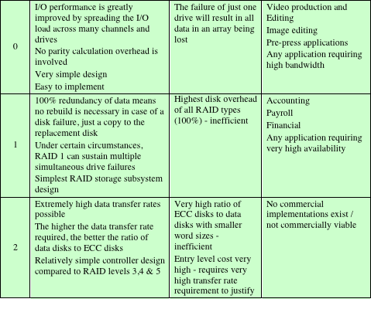
Tablo 6.4
RAID Karşılaştırma
(1/2)
Notes:
Table 6.4 is a comparative summary of the seven levels.

Slide 29
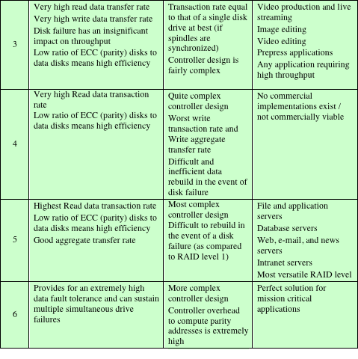
Tablo 6.4
RAID Karşılaştırma
(2/2)
Notes:
Table 6.4 RAID comparison (page 2 of 2)

Slide 30
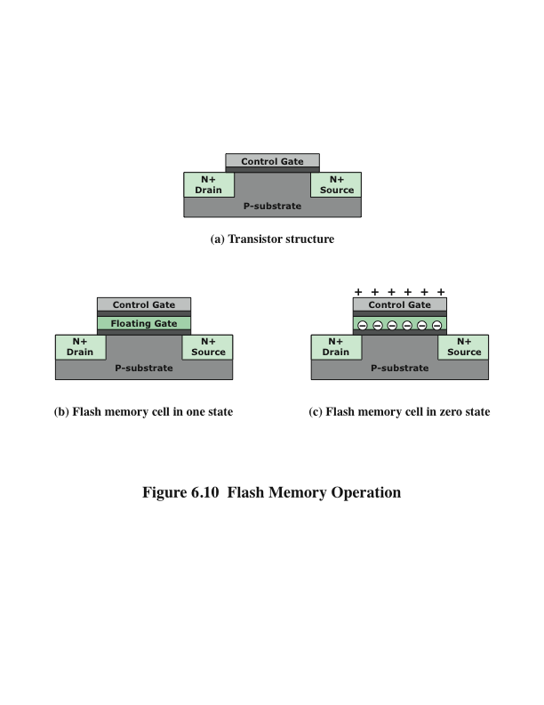
Şekil 6.10 Flash Bellek İşlemi
Flash
Bellek
Notes:
Figure 6.10 illustrates the basic operation of a flash memory. For comparison,
Figure 6.10a depicts the operation of a transistor. Transistors exploit the properties
of semiconductors so that a small voltage applied to the gate can be used to control
the flow of a large current between the source and the drain.
In a flash memory cell, a second gate—called a floating gate, because it is insulated
by a thin oxide layer—is added to the transistor. Initially, the floating gate
does not interfere with the operation of the transistor (Figure 6.10b). In this state,
the cell is deemed to represent binary 1. Applying a large voltage across the oxide
layer causes electrons to tunnel through it and become trapped on the floating gate,
where they remain even if the power is disconnected (Figure 6.10c). In this state, the
cell is deemed to represent binary 0. The state of the cell can be read by using external
circuitry to test whether the transistor is working or not. Applying a large voltage
in the opposite direction removes the electrons from the floating gate, returning
to a state of binary 0.

Slide 31
Solid State Sürücü (SSD)
Bir sabit disk sürücüsünün (HDD) yerine geçebilen yarı iletken bileşenlerle yapılmış bir bellek aygıtı
“Solid state” yarıiletkenlerle oluşturulmuş elektronik devre anlamına gelmektedir.
Flash bellek
Akıllı telefonlar, GPS cihazları, MP3 çalarlar, dijital kameralar ve USB cihazları da dahil olmak üzere birçok elektronik üründe kullanılan bir yarı iletken hafıza türü
Maliyet ve performans, açısından HDD'lerin yerini alabilecek b,r noktaya gelmiştir.
İki farklı flash bellek tipi:
NOR
Temel erişim birimi bittir
Yüksek hızda rastgele erişim sağlar
Cep telefonunun işletim sistemi kodunu ve Windows bilgisayarlarında başlangıçta çalışan BIOS programını depolamak için kullanılır
NAND
Temel erişim birimi 16 veya 32 bittir
Okuma ve yazma küçük bloklar halindedir
USB flash sürücüleri, hafıza kartları ve SSDlerde kullanılır
Rasgele erişimli harici adres veriyolu sağlamaz, bundan dolayı veriler blok-bazlı olarak okunmalıdır
Notes:
One of the most significant developments in computer architecture in recent years
is the increasing use of solid state drives (SSDs) to complement or even replace
hard disk drives (HDDs), both as internal and external secondary memory. The
term solid state refers to electronic circuitry built with semiconductors. A solid state
drive is a memory device made with solid state components that can be used as a
replacement to a hard disk drive. The SSDs now on the market and coming on line
use a type of semiconductor memory referred to as flash memory. In this section,
we first provide an introduction to flash memory, and then look at its use in SSDs.
Flash memory is a type of semiconductor memory that has been around for a number
of years and is used in many consumer electronic products, including smart
phones, GPS devices, MP3 players, digital cameras, and USB devices. In recent
years, the cost and performance of flash memory has evolved to the point where it is
feasible to use flash memory drives to replace HDDs.
There are two distinctive types of flash memory, designated as NOR and
NAND. In NOR flash memory, the basic unit of access is a bit, and the logical
organization resembles a NOR logic device. For NAND flash memory, the basic
unit is 16 or 32 bits, and the logical organization resembles NAND devices.
NOR flash memory provides high-speed random access. It can read and
write data to specific locations, and can reference and retrieve a single byte. NOR
flash memory is used to store cell phone operating system code and on Windows
computers for the BIOS program that runs at startup. NAND reads and writes in
small blocks. It is used in USB flash drives, memory cards (in digital cameras, MP3
players, etc.), and in SSDs. NAND provides higher bit density than NOR and greater
write speed. NAND flash does not provide a random-access external address bus so
the data must be read on a block-wise basis (also known as page access), where each
block holds hundreds to thousands of bits.

Slide 32
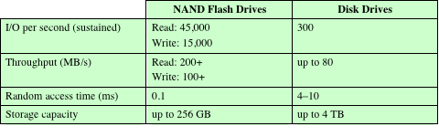
SSD ve HDD Karşılaştırması
Tablo
6.5
SSD'lerin HDD'lere göre aşağıdaki avantajları vardır:
Saniye başına yüksek performanslı girdi/çıktı işlemleri (IOPS)
Dayanıklılık
Daha uzun ömür
Düşük güç tüketimi
Sessiz ve daha soğuk çalışma kapasitesi
Düşük erişim zamanı ve gecikme oranı
Karşılaştırmalar
Notes:
As the cost of flash-based SSDs has dropped and the performance and bit density
increased, SSDs have become increasingly competitive with HDDs. Table 6.5 shows
typical measures of comparison at the time of this writing.
SSDs have the following advantages over HDDs:
• High-performance input/output operations per second (IOPS): Significantly
increases performance I/O subsystems.
• Durability: Less susceptible to physical shock and vibration.
• Longer lifespan: SSDs are not susceptible to mechanical wear.
• Lower power consumption: SSDs use as little as 2.1 watts of power per drive,
considerably less than comparable-size HDDs.
• Quieter and cooler running capabilities: Less floor space required, lower
energy costs, and a greener enterprise.
• Lower access times and latency rates: Over 10 times faster than the spinning
disks in an HDD.
Currently, HDDs enjoy a cost per bit advantage and a capacity advantage, but
these differences are shrinking.

Slide 33
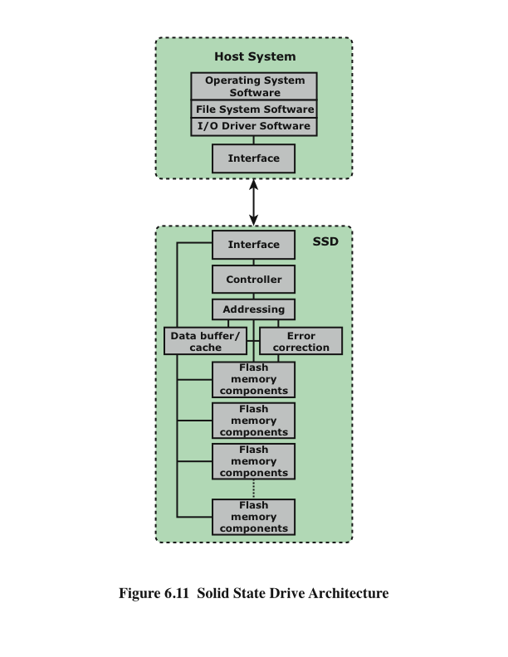
SSD Organizasyonu
Notes:
Figure 6.11 illustrates a general view of the common architectural system component
associated with any SDD system. On the host system, to operating system invokes
file system software to access data on the disk. The file system, in turn, invokes I/O
driver software. The I/O driver software provides host access to the particular SSD
product. The interface component in Figure 6.11 refers to the physical and electrical
interface between the host processor and the SSD peripheral device. If the device is
an internal hard drive, a common interface is PCIe. For external devices, one common
interface is USB.
In addition to the interface to the host system, the SSD contains the following
components:
• Controller: Provides SSD device level interfacing and firmware execution.
• Addressing: Logic that performs the selection function across the flash
memory components.
• Data buffer/cache: High speed RAM memory components used for speed
matching and to increased data throughput.
• Error correction: Logic for error detection and correction.
• Flash memory components: Individual NAND flash chips.

Slide 34
Pratik Konular
SSD'lere özgü olup HDD'lerde bulunmayan iki pratik konu var:
Belirli sayıdaki yazma işleminden sonra flash bellek kullanılamaz hale gelir
Daha uzun kullanım için:
Yazma işlemlerini geciktirmek ve gruplamak için flash önbellek olarak kullanılır
Yazıları hücre bloklarına dağıtmak için wear-leveling algoritmaları kullanılır
Bad-block yönetim teknikleri
Çoğu flash aygıtı, kalan ömürlerini tahmin eder; böylece sistemler, başarısızlığı öngörebilir ve önlemler alabilirler
SDD performansı, cihaz kullanıldıkça yavaşlama eğilimi gösterir
Bloğun tamamı flash bellekten okunmalı ve bir RAM tamponuna yerleştirilmelidir
Blok, flash belleğe geri yazılmadan önce flash belleğin tüm bloğu silinmelidir
Tampondaki tüm blok flash belleğe geri yazılır
Notes:
There are two practical issues peculiar to SSDs that are not faced by HDDs. First,
SDD performance has a tendency to slow down as the device is used. To understand
the reason for this, you need to know that files are stored on disk as a set of pages,
typically 4 KB in length. These pages are not necessarily, and indeed not typically,
stored as a contiguous set of pages on the disk. The reason for this arrangement is
explained in our discussion of virtual memory in Chapter 8. However, flash memory
is accessed in blocks, with a typically block size of 512 KB, so that there are typically
128 pages per block. Now consider what must be done to write a page onto a flash
memory.
1. The entire block must be read from the flash memory and placed in a RAM
buffer. Then the appropriate page in the RAM buffer is updated.
2. Before the block can be written back to flash memory, the entire block of flash
memory must be erased—it is not possible to erase just one page of the flash
memory.
3. The entire block from the buffer is now written back to the flash memory.
Now, when a flash drive is relatively empty and a new file is created, the
pages of that file are written on to the drive contiguously, so that one or only a few
blocks are affected. However, over time, because of the way virtual memory works,
files become fragmented, with pages scattered over multiple blocks. As the drive
become more occupied, there is more fragmentation, so the writing of a new file can
affect multiple blocks. Thus, the writing of multiple pages from one block becomes
slower, the more fully occupied the disk is. Manufacturers have developed a variety
of techniques to compensate for this property of flash memory, such as setting aside
a substantial portion of the SSD as extra space for write operations (called over provisioning),
then to erase inactive pages during idle time used to defragment the
disk. Another technique is the TRIM command, which allows an operating system
to inform a solid state drive (SSD) which blocks of data are no longer considered in
use and can be wiped internally.
A second practical issue with flash memory drives is that a flash memory
becomes unusable after a certain number of writes. As flash cells are stressed,
they lose their ability to record and retain values. A typical limit is 100,000 writes
[GSOE08]. Techniques for prolonging the life of an SSD drive include front-ending
the flash with a cache to delay and group write operations, using wear-leveling algorithms
that evenly distribute writes across block of cells, and sophisticated bad-block
management techniques. In addition, vendors are deploying SSDs in RAID configurations
to further reduce the probability of data loss. Most flash devices are also
capable of estimating their own remaining lifetimes so systems can anticipate failure
and take preemptive action.

Slide 35
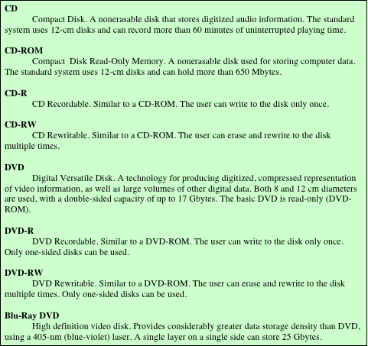
Tablo 6. 6
Optik
Disk
Ürünleri
Notes:
In 1983, one of the most successful consumer products of all time was introduced:
the compact disk (CD) digital audio system. The CD is a non-erasable disk that can
store more than 60 minutes of audio information on one side. The huge commercial
success of the CD enabled the development of low-cost optical-disk storage
technology that has revolutionized computer data storage. A variety of optical-disk
systems have been introduced (Table 6.6). We briefly review each of these.

Slide 36
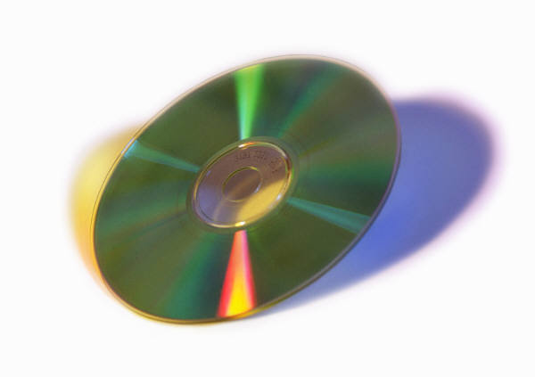
Compact Disk Read-Only Memory (CD-ROM)
Ses CD'si ve CD-ROM benzer bir teknolojiyi paylaşıyor
Temel fark, CD-ROM oynatıcıların daha dayanıklı olması ve verilerin düzgün aktarılmasını sağlamak için hata düzeltme aygıtlarına sahip olmasıdır
Üretim:
Disk, polikarbonat gibi bir reçineden oluşur
Dijital olarak kaydedilen bilgiler, polikarbonat yüzeyinde bir seri mikroskobik nokta olarak basılır
Bu, bir ana disk oluşturmak için ince odaklanmış, yüksek yoğunluklu bir lazer ile yapılır
Master, polikarbonat üzerine kopyalar oluşturmak için kullanılır
Çukurlu yüzey daha sonra genellikle alüminyum veya altın yansıtıcı bir yüzeyle kaplanır
Bu parlak yüzey, açık akrilik üst katmanla toz ve çizilmelere karşı korunmuştur
Sonunda bir etiket akrilik üzerine yazılır
Notes:
Both the audio CD and the CD-ROM (compact disk read-only
memory) share a similar technology. The main difference is that CD-ROM players
are more rugged and have error correction devices to ensure that data are properly
transferred from disk to computer. Both types of disk are made the same way. The
disk is formed from a resin, such as polycarbonate. Digitally recorded information
(either music or computer data) is imprinted as a series of microscopic pits on the
surface of the polycarbonate. This is done, first of all, with a finely focused, high intensity
laser to create a master disk. The master is used, in turn, to make a die to
stamp out copies onto polycarbonate. The pitted surface is then coated with a highly
reflective surface, usually aluminum or gold. This shiny surface is protected against
dust and scratches by a top coat of clear acrylic. Finally, a label can be silkscreened
onto the acrylic.

Slide 37
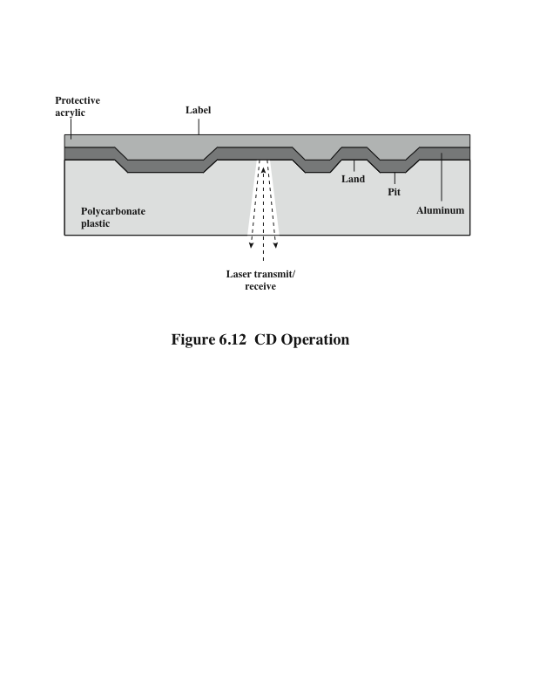
CD İşlemi
Notes:
Information is retrieved from a CD or CD-ROM by a low-powered laser
housed in an optical-disk player, or drive unit. The laser shines through the clear
polycarbonate while a motor spins the disk past it (Figure 6.12). The intensity of
the reflected light of the laser changes as it encounters a pit. Specifically, if the laser
beam falls on a pit, which has a somewhat rough surface, the light scatters and a low
intensity is reflected back to the source. The areas between pits are called lands.
A land is a smooth surface, which reflects back at higher intensity. The change
between pits and lands is detected by a photo sensor and converted into a digital
signal. The sensor tests the surface at regular intervals. The beginning or end of
a pit represents a 1; when no change in elevation occurs between intervals, a 0 is
recorded.
Recall that on a magnetic disk, information is recorded in concentric tracks.
With the simplest constant angular velocity (CAV) system, the number of bits per
track is constant. An increase in density is achieved with multiple zoned recording,
in which the surface is divided into a number of zones, with zones farther from the
center containing more bits than zones closer to the center. Although this technique
increases capacity, it is still not optimal.
To achieve greater capacity, CDs and CD-ROMs do not organize information
on concentric tracks. Instead, the disk contains a single spiral track, beginning near
the center and spiraling out to the outer edge of the disk. Sectors near the outside
of the disk are the same length as those near the inside. Thus, information is packed
evenly across the disk in segments of the same size and these are scanned at the
same rate by rotating the disk at a variable speed. The pits are then read by the laser
at a constant linear velocity (CLV). The disk rotates more slowly for accesses near
the outer edge than for those near the center. Thus, the capacity of a track and the
rotational delay both increase for positions nearer the outer edge of the disk. The
data capacity for a CD-ROM is about 680 MB.

Slide 38
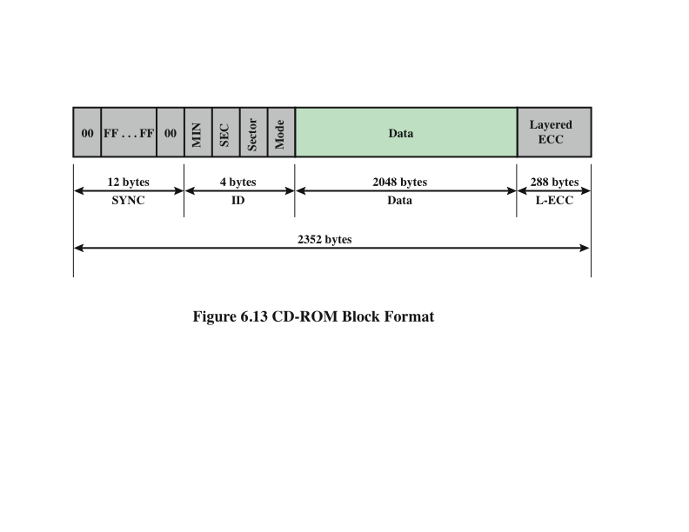
CD-ROM Blok Formatı
Notes:
Data on the CD-ROM are organized as a sequence of blocks. A typical block
format is shown in Figure 6.13. It consists of the following fields:
• Sync: The sync field identifies the beginning of a block. It consists of a byte of
all 0s, 10 bytes of all 1s, and a byte of all 0s.
• Header: The header contains the block address and the mode byte. Mode
0 specifies a blank data field; mode 1 specifies the use of an error-correcting
code and 2048 bytes of data; mode 2 specifies 2336 bytes of user data with no
error-correcting code.
• Data: User data.
• Auxiliary: Additional user data in mode 2. In mode 1, this is a 288-byte error correcting
code.
With the use of CLV, random access becomes more difficult. Locating a specific
address involves moving the head to the general area, adjusting the rotation
speed and reading the address, and then making minor adjustments to find and
access the specific sector.

Slide 39
CD-ROM
CD-ROM, büyük miktarda verinin çok sayıda kullanıcıya dağıtılması için uygundur
Başlangıçtaki yazma sürecinin masrafları nedeniyle, bireysel uygulamalar için uygun değildir
CD-ROM iki avantaja sahiptir:
Optik disk, üzerinde depolanan bilgilerle birlikte, masrafsız olarak çoğaltılabilir
Optik disk çıkarılabilir, böylece diskin kendisinin arşivleme için kullanılabilir
CD-ROM’un dezavantajları:
Salt okunur ve güncellenemez
Bir manyetik disk sürücüsünden daha uzun bir erişim süresine sahiptir
Notes:
CD-ROM is appropriate for the distribution of large amounts of data to a
large number of users. Because of the expense of the initial writing process, it is not
appropriate for individualized applications. Compared with traditional magnetic
disks, the CD-ROM has two advantages:
• The optical disk together with the information stored on it can be mass replicated
inexpensively—unlike a magnetic disk. The database on a magnetic disk
has to be reproduced by copying one disk at a time using two disk drives.
• The optical disk is removable, allowing the disk itself to be used for archival
storage. Most magnetic disks are non-removable. The information on non-removable
magnetic disks must first be copied to another storage medium
before the disk drive/disk can be used to store new information.
The disadvantages of CD-ROM are as follows:
• It is read-only and cannot be updated.
• It has an access time much longer than that of a magnetic disk drive, as much
as half a second.

Slide 40
CD Recordable CD Rewritable (CD-R) (CD-RW)
Salt yazılır, istenildiği kadar okunabilir
Bir veri kümesinin yalnızca bir veya az sayıda kopyasına ihtiyaç duyan uygulamaları barındırır
Disk, daha sonra yeterli yoğunluklu bir lazer ışını ile bir kez yazılabilecek şekilde hazırlanır
Ortam, yansıma oranını değiştirmek için kullanılan ve yüksek yoğunluklu bir lazerle aktive edilen bir boya katmanı içerir
Büyük miktarda kullanıcı verisinin kalıcı bir kaydını sağlar
Hem istenilen sayıda yazma hem de üzerine yazma yapılabilir
Faz değiştirme diski, iki farklı faz durumunda iki önemli ölçüde farklı yansıma özelliklerine sahip bir malzeme kullanıyor
Amorf hal
Moleküller ışığı kötü yansıtan rastgele bir yönlendirme gösterirler
Kristal hal
Işığı iyi yansıtan pürüzsüz bir yüzeye sahiptir
Bir lazer ışığı, materyali bir fazdan diğerine değiştirebilir
Dezavantaj, maddenin sonunda ve kalıcı olarak istenen özelliklerini kaybediyor olmasıdır
Avantajı, yeniden yazılabilir olmasıdır
Notes:
To accommodate applications in which only one or a small
number of copies of a set of data is needed, the write-once read-many CD, known
as the CD recordable (CD-R), has been developed. For CD-R, a disk is prepared
in such a way that it can be subsequently written once with a laser beam of
modest -intensity. Thus, with a some what more expensive disk controller than for
CD-ROM, the customer can write once as well as read the disk.
The CD-R medium is similar to but not identical to that of a CD or
CD-ROM. For CDs and CD-ROMs, information is recorded by the pitting of
the surface of the medium, which changes reflectivity. For a CD-R, the medium
includes a dye layer. The dye is used to change reflectivity and is activated
by a high-intensity laser. The resulting disk can be read on a CD-R drive or a
CD-ROM drive.
The CD-R optical disk is attractive for archival storage of documents and files.
It provides a permanent record of large volumes of user data.
The CD-RW optical disk can be repeatedly written and
overwritten, as with a magnetic disk. Although a number of approaches have been
tried, the only pure optical approach that has proved attractive is called phase
change. The phase change disk uses a material that has two significantly different
reflectivities in two different phase states. There is an amorphous state, in which the
molecules exhibit a random orientation that reflects light poorly; and a crystalline
state, which has a smooth surface that reflects light well. A beam of laser light can
change the material from one phase to the other. The primary disadvantage of
phase change optical disks is that the material eventually and permanently loses
its desirable properties. Current materials can be used for between 500,000 and
1,000,000 erase cycles.
The CD-RW has the obvious advantage over CD-ROM and CD-R that it can
be rewritten and thus used as a true secondary storage. As such, it competes with
magnetic disk. A key advantage of the optical disk is that the engineering tolerances
for optical disks are much less severe than for high-capacity magnetic disks. Thus,
they exhibit higher reliability and longer life.

Slide 41
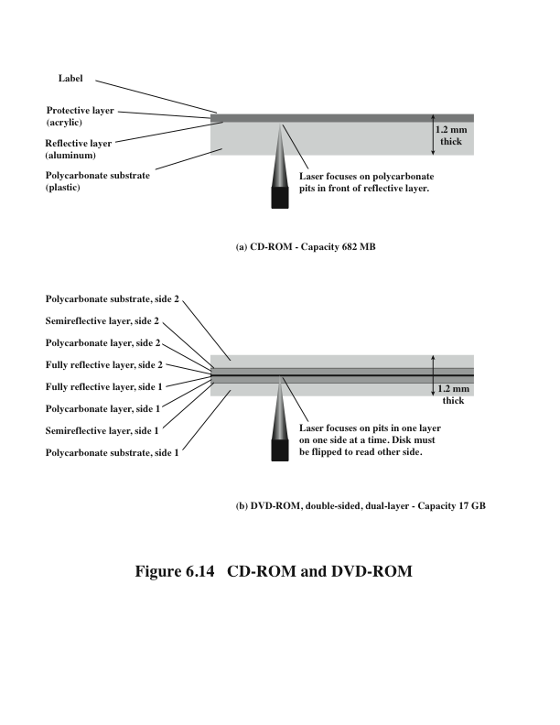
Digital Versatile Disk (DVD)
Notes:
With the capacious digital versatile disk (DVD), the electronics industry has at last
found an acceptable replacement for the analog VHS video tape. The DVD has
replaced the videotape used in video cassette recorders (VCRs) and, more important
for this discussion, replace the CD-ROM in personal computers and servers.
The DVD takes video into the digital age. It delivers movies with impressive picture
quality, and it can be randomly accessed like audio CDs, which DVD machines
can also play. Vast volumes of data can be crammed onto the disk, currently seven
times as much as a CD-ROM. With DVD’s huge storage capacity and vivid quality,
PC games have become more realistic and educational software incorporates more
video. Following in the wake of these developments has been a new crest of traffic
over the Internet and corporate intranets, as this material is incorporated into
Web sites.
The DVD’s greater capacity is due to three differences from CDs (Figure 6.14):
1. Bits are packed more closely on a DVD. The spacing between loops of a spiral on a
CD is 1.6 μm and the minimum distance between pits along the spiral is 0.834 μm.
The DVD uses a laser with shorter wavelength and achieves a loop spacing of
0.74 μm and a minimum distance between pits of 0.4 μm. The result of these
two improvements is about a seven-fold increase in capacity, to about 4.7 GB.
2. The DVD employs a second layer of pits and lands on top of the first layer. A
dual-layer DVD has a semi-reflective layer on top of the reflective layer, and
by adjusting focus, the lasers in DVD drives can read each layer separately.
This technique almost doubles the capacity of the disk, to about 8.5 GB. The
lower reflectivity of the second layer limits its storage capacity so that a full
doubling is not achieved.
3. The DVD-ROM can be two sided, whereas data are recorded on only one side
of a CD. This brings total capacity up to 17 GB.

Slide 42
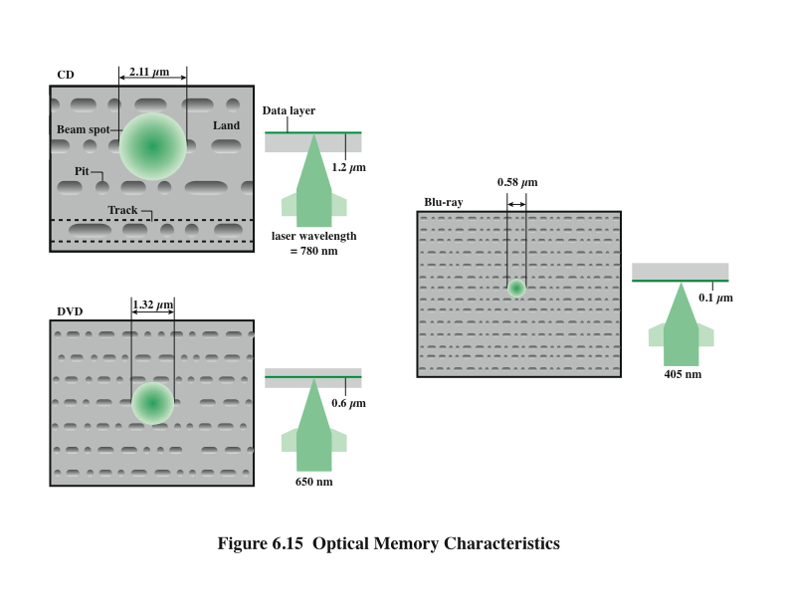
High-Definition
Optical Disks
Notes:
High-definition optical disks are designed to store high-definition videos and to
provide significantly greater storage capacity compared to DVDs. The higher bit
density is achieved by using a laser with a shorter wavelength, in the blue-violet
range. The data pits, which constitute the digital 1s and 0s, are smaller on the high-definition
optical disks compared to DVD because of the shorter laser wavelength.
Two competing disk formats and technologies initially competed for market
acceptance: HD DVD and Blu-ray DVD. The Blu-ray scheme ultimately achieved
market dominance. The HD DVD scheme can store 15 GB on a single layer on a
single side. Blu-ray positions the data layer on the disk closer to the laser (shown on
the right-hand side of each diagram in Figure 6.15). This enables a tighter focus and
less distortion and thus smaller pits and tracks. Blu-ray can store 25 GB on a single
layer. Three versions are available: read only (BD-ROM), recordable once (BD-R),
and re-recordable (BD-RE).

Slide 43
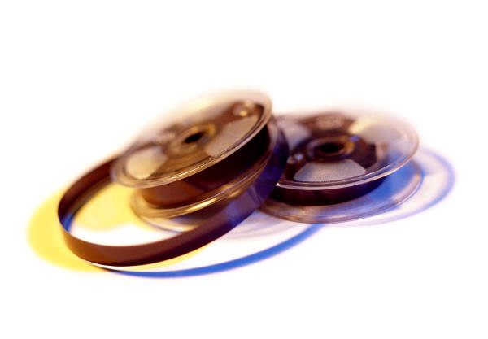
Manyetik Bant
Bant sistemleri disk sistemleri ile aynı okuma ve kayıt tekniklerini kullanır
Ortası, mıknatıslanabilir malzeme ile kaplanmış esnek polyester banttır
Kaplama, özel bağlayıcılarda saf metal parçacıklarından veya buharla kaplanmış metal filmlerden oluşabilir
Banttaki veriler, uzunlamasına olarak ilerleyen bir dizi paralel parça olarak yapılandırılmıştır
Seri Kayıt
Veriler, her iz boyunca bit dizisi olarak düzenlenir
Veri, fiziksel kayıtlar olarak adlandırılan bitişik bloklara okunur ve yazılır
Bant üzerindeki bloklar, kayıtlar arası boşluklar olarak adlandırılan boşluklarla ayrılır
Notes:
Tape systems use the same reading and recording techniques as disk systems. The
medium is flexible polyester (similar to that used in some clothing) tape coated with
magnetizable material. The coating may consist of particles of pure metal in special
binders or vapor-plated metal films. The tape and the tape drive are analogous
to a home tape recorder system. Tape widths vary from 0.38 cm (0.15 inch) to
1.27 cm (0.5 inch). Tapes used to be packaged as open reels that have to be threaded
through a second spindle for use. Today, virtually all tapes are housed in cartridges.
Data on the tape are structured as a number of parallel tracks running lengthwise.
Earlier tape systems typically used nine tracks. This made it possible to store
data one byte at a time, with an additional parity bit as the ninth track. This was
followed by tape systems using 18 or 36 tracks, corresponding to a digital word or
double word. The recording of data in this form is referred to as parallel recording.
Most modern systems instead use serial recording, in which data are laid out as a
sequence of bits along each track, as is done with magnetic disks. As with the disk,
data are read and written in contiguous blocks, called physical records, on a tape.
Blocks on the tape are separated by gaps referred to as inter-record gaps. As with the
disk, the tape is formatted to assist in locating physical records.

Slide 44
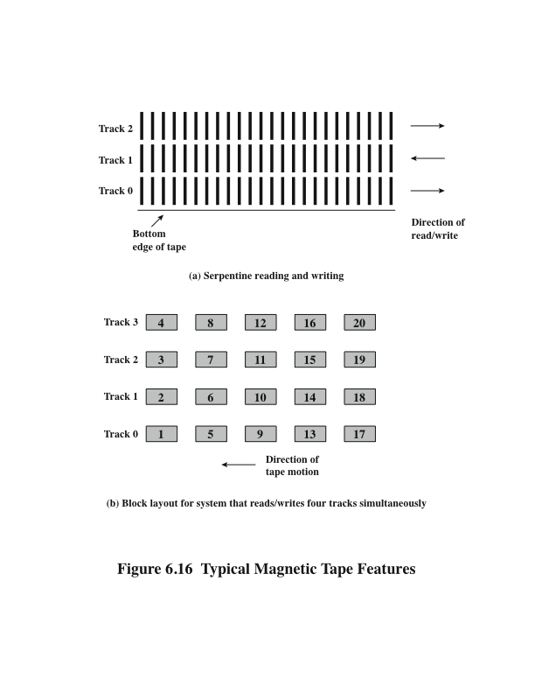
Manyetik Bant Özellikleri
Notes:
The typical recording technique used in serial tapes is referred to as serpentine
recording. In this technique, when data are being recorded, the first set of bits is
recorded along the whole length of the tape. When the end of the tape is reached,
the heads are repositioned to record a new track, and the tape is again recorded on
its whole length, this time in the opposite direction. That process continues, back
and forth, until the tape is full (Figure 6.16a). To increase speed, the read-write
head is capable of reading and writing a number of adjacent tracks simultaneously
(typically two to eight tracks). Data are still recorded serially along individual tracks,
but blocks in sequence are stored on adjacent tracks, as suggested by Figure 6.16b.
A tape drive is a sequential-access device. If the tape head is positioned at
record 1, then to read record N, it is necessary to read physical records 1 through
N - 1, one at a time. If the head is currently positioned beyond the desired record, it
is necessary to rewind the tape a certain distance and begin reading forward. Unlike
the disk, the tape is in motion only during a read or write operation.
In contrast to the tape, the disk drive is referred to as a direct-access device. A
disk drive need not read all the sectors on a disk sequentially to get to the desired
one. It must only wait for the intervening sectors within one track and can make successive
accesses to any track.
Magnetic tape was the first kind of secondary memory. It is still widely used as
the lowest-cost, slowest-speed member of the memory hierarchy.

Slide 45
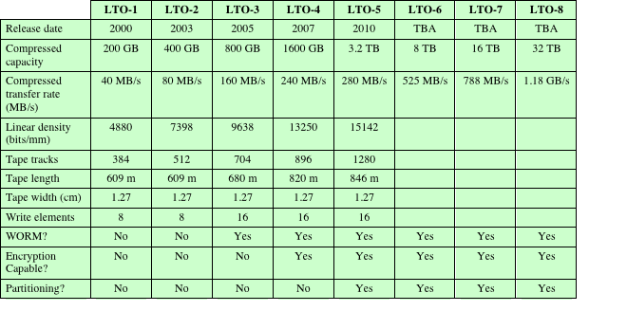
Tablo 6.7 LTO Bant Sürücüleri
Notes:
The dominant tape technology today is a cartridge system known as linear
tape-open (LTO). LTO was developed in the late 1990s as an open-source alternative
to the various proprietary systems on the market. Table 6.7 shows parameters
for the various LTO generations. See Appendix J for details.

Slide 46
Özet
Harici Bellek
Bölüm 6
RAID
RAID seviye 0
RAID seviye 1
RAID seviye 2
RAID seviye 3
RAID seviye 4
RAID seviye 5
RAID seviye 6
Optik bellek
Compact disk
Digital versatile disk
High-definition optical disks
Manyetik disk
Manyetik okuma ve yazma mekanizmaları
Veri düzenleme ve formatlama
Fiziksel Karakteristikler
Disk performansı ve parametreleri
Solid state sürücüler
Flash bellek
SSD-HDD Karşılaştırması
SSD organizasyonu
Pratik konular
Manyetik bant
Notes:
Chapter 6 summary.

